Slide 1




Indian Institute of Information Technology Sri City, Chittoor
(An Institute of National Importance Under An Act of Parliament)
IOT PROJECT
IoT based Fall Detection & Health Monitoring System
GROUP 3 - HEALTH CARE
SHANMATHE S A - S20220010200
YASHWANTH S - S20220020323

Slide 2



INTRODUCTION
Purpose:
Introduce the goal of the project – a health monitoring system capable of tracking heart rate, oxygen levels (SpO2), detecting falls, and sending real-time alerts.
Key Components:
Sensors (Heart Rate, SpO2, Accelerometer)
Client
Server
Firebase
Application

Slide 3
PROBLEM STATEMENT
Need for Health Monitoring:
With aging populations and health issues, constant monitoring of heart rate, oxygen levels, and falls is critical.
Current Gaps:
Lack of real-time alerts and centralized data monitoring, making it harder for caregivers and medical personnel to react quickly to health emergencies.

Slide 4
OBJECTIVES
Real-time monitoring of heart rate, SpO2, and fall detection.
Sending warnings in case of abnormalities (e.g., low/high heart rate, oxygen level drops, fall detected).
Storing data based on timestamp for historical reference and analysis.
Integration with Firebase for real-time updates.
Dashboard: A React-based dashboard that shows real-time data and has a built-in chatbot for quick assistance.
Components Used:
Sensors: MAX30100 (for Heart Rate and SpO2), MPU6050 (for fall detection).
Actuator: Buzzer
Microcontroller: Raspberry Pi (Both Server and Client)
Server: Receives data from sensors and stores/forwards it to Firebase.
Firebase: Real-time database for storing and showing health data.
Website: Displays data and sends alerts.

Slide 5
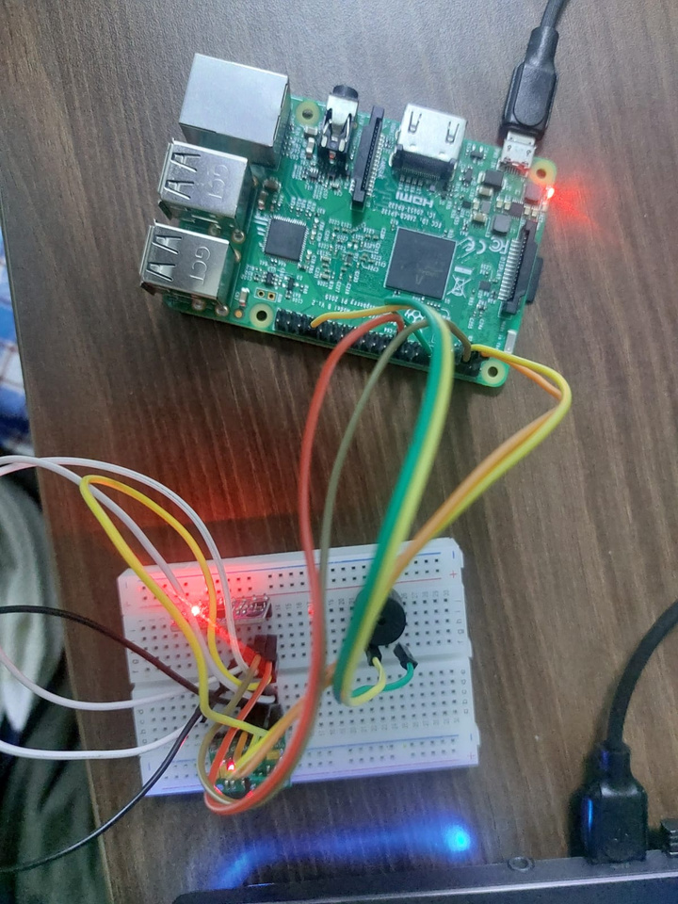
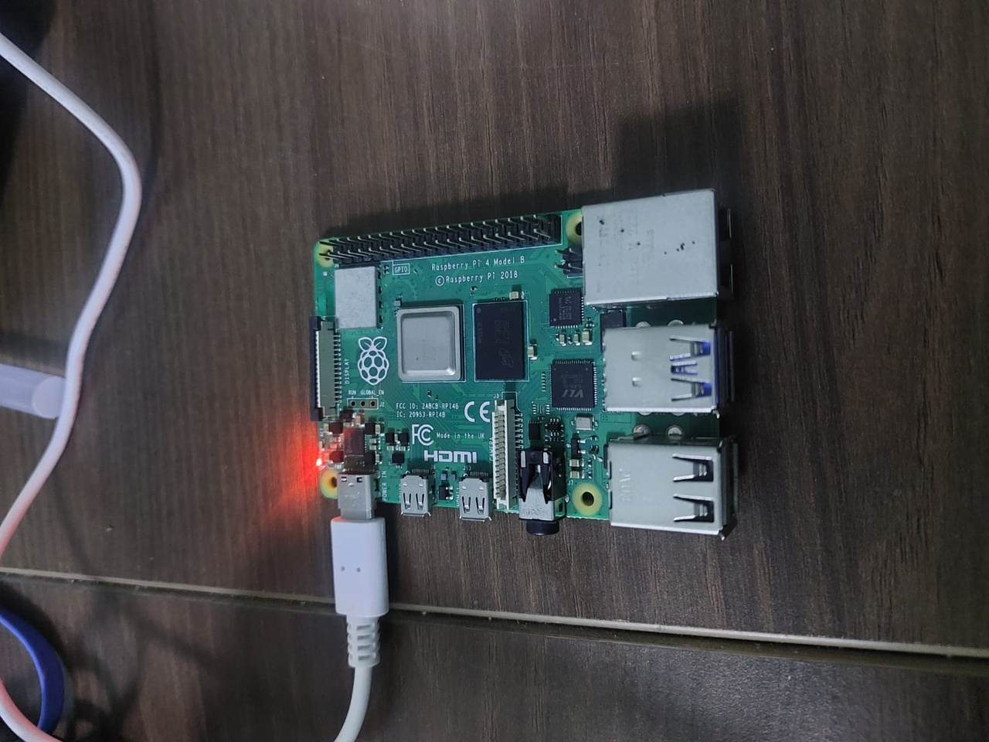
SCREENSHOTS
Client - RaspberryPi 3B
Server - RaspberryPi 4

Slide 6
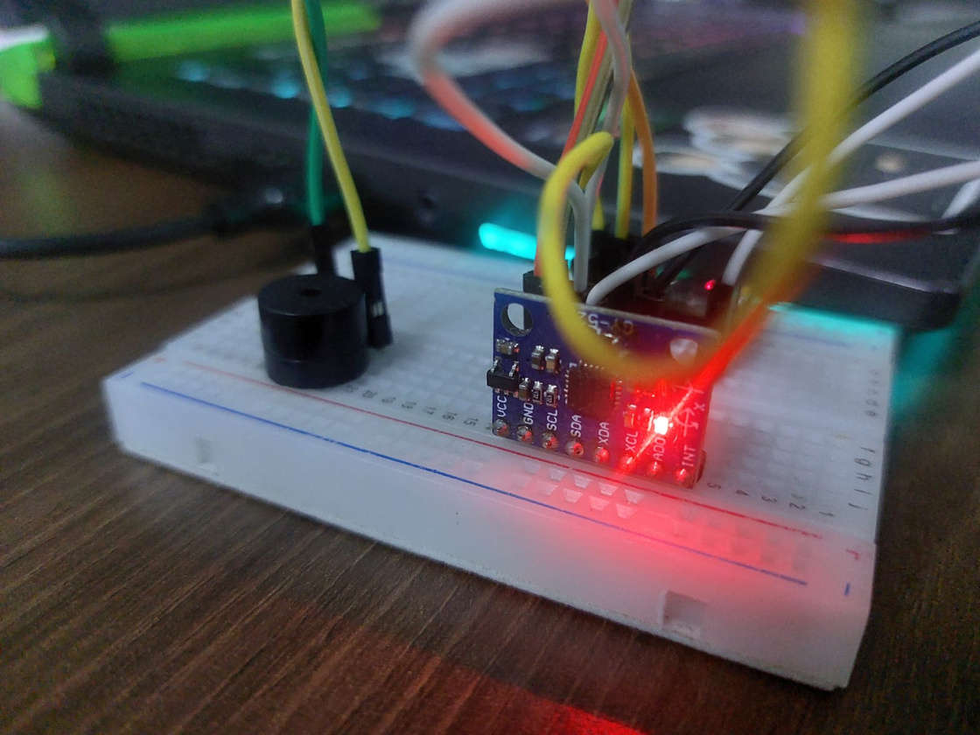
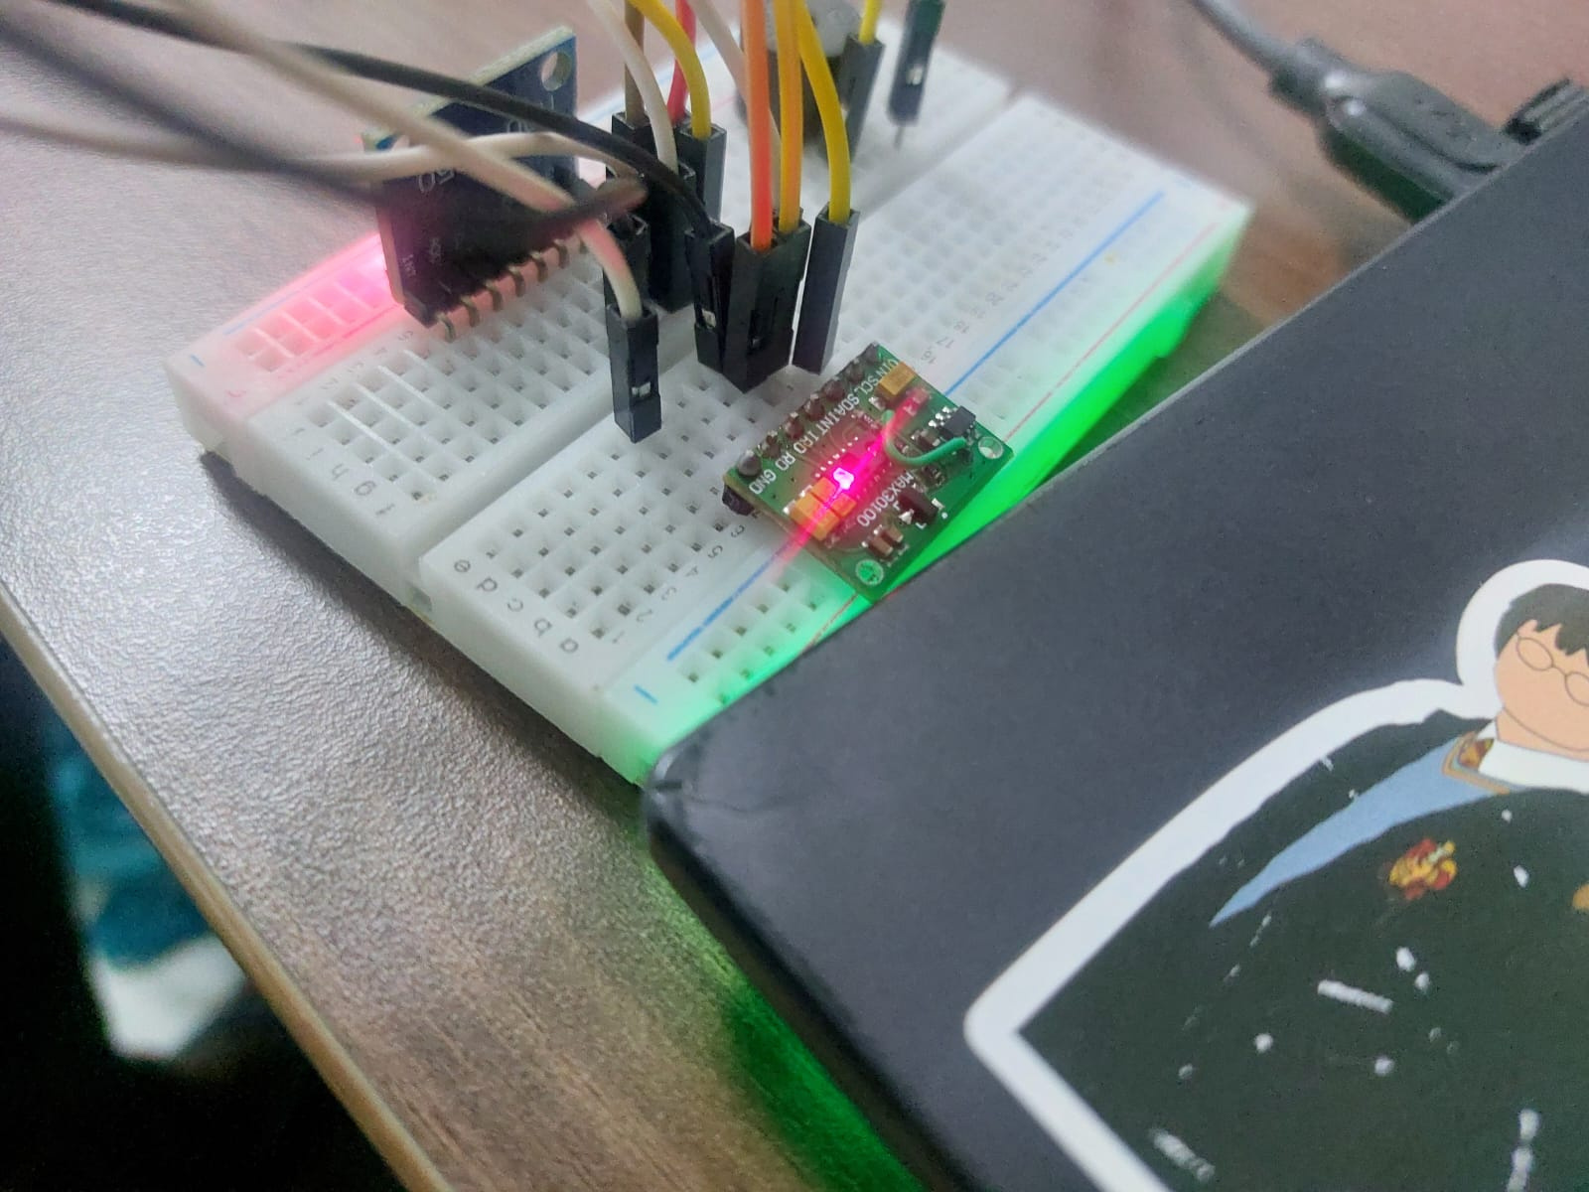
SCREENSHOTS
MPU-6050
MAX30100

Slide 7
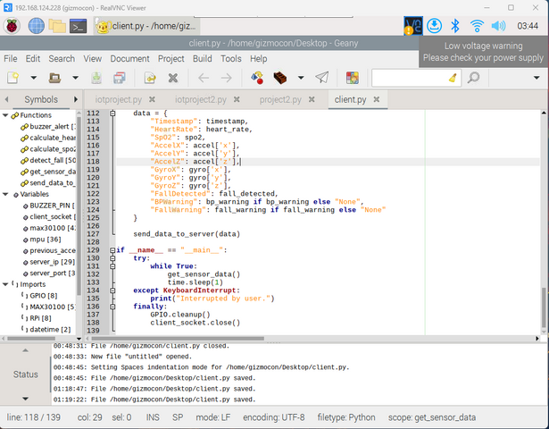
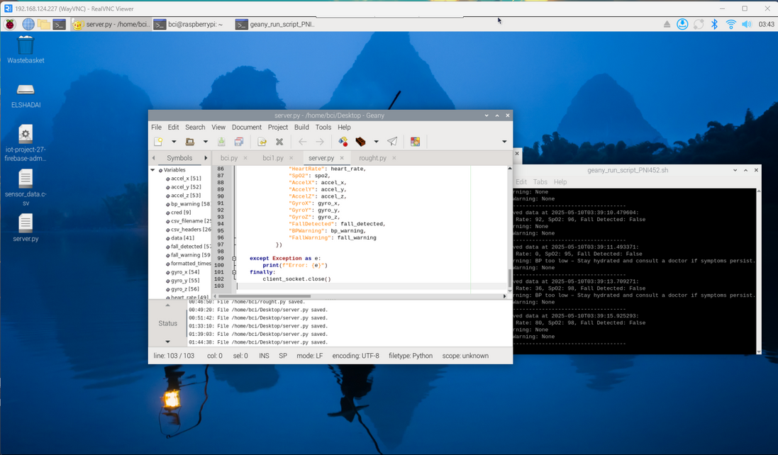
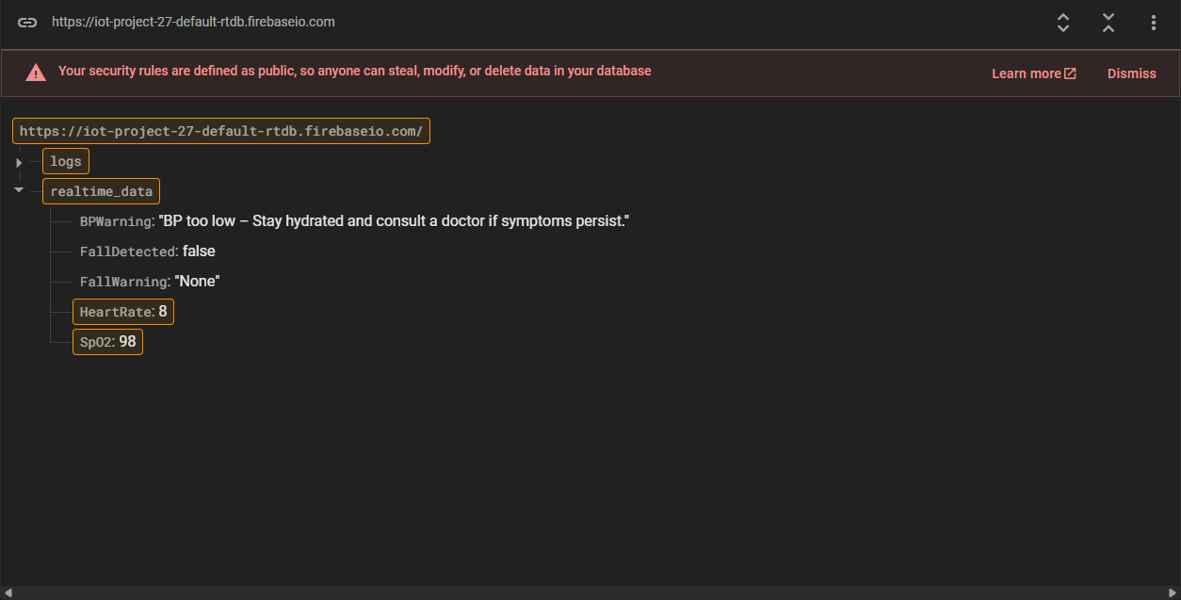
SCREENSHOTS
Server Side
Client Side
Firebase

Slide 8
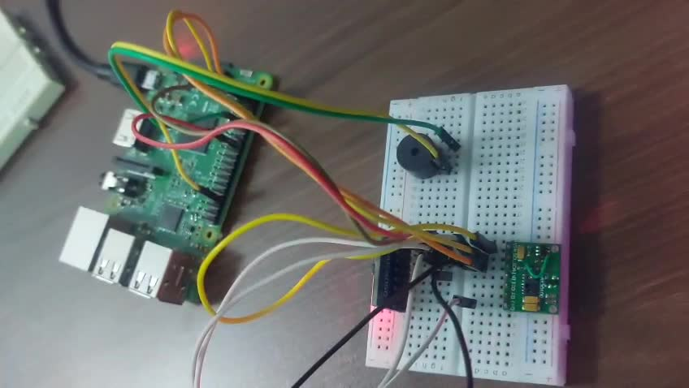
DEMO VIDEO

Slide 9
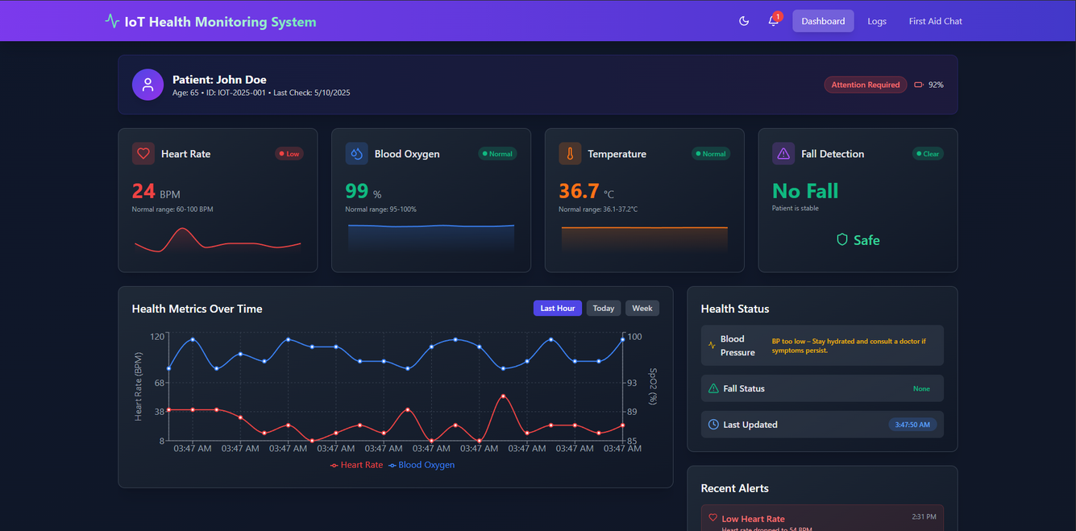
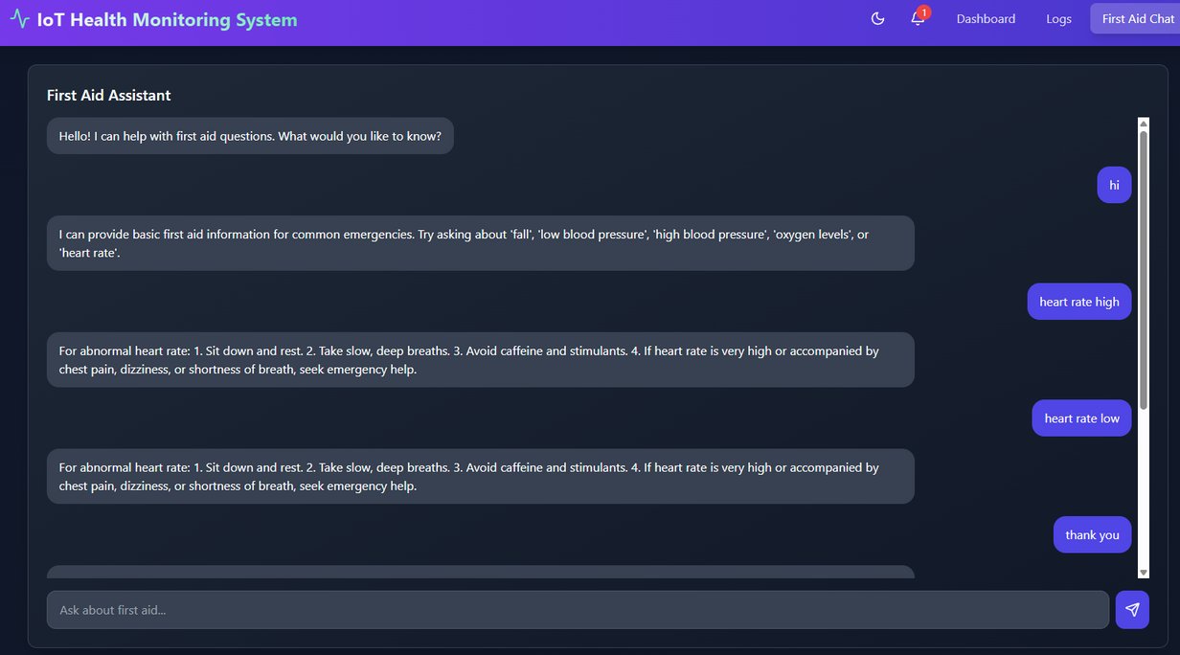
DASHBOARD

Slide 10
ALERT SYSTEM & REAL-TIME MONITORING
Alerts:
Buzzer: Sound alert when thresholds are exceeded (e.g., fall detected, low BP, abnormal heart rate).
Firebase: Push warnings to application when a critical health event is detected (e.g., low SpO2, high BP).
REAL-TIME FIREBASE INTEGRATION
Data Storage:
Firebase stores real-time health data with timestamps.
Historical logs for review by healthcare professionals.
Real-Time Monitoring:
Health data, warnings, and logs are immediately updated on Firebase, accessible via any device.

Slide 11
DATA FLOW
Flow of Data:
Sensors read heart rate, SpO2, and fall data.
Raspberry Pi handles data processing and sends it to the server.
Server evaluates the data (checks for abnormalities).
Alerts sent via buzzer and Firebase notifications if abnormalities are detected.
Data Logged: Health data and alerts are stored in Firebase.
Dashboard: Displays data, graphs, and alerts in real time

Slide 12
CHALLENGES
NodeMCU Issues:
Initially started with NodeMCU, but I2C bus conflicts prevented smooth sensor communication.
Difficulties in managing multiple sensors on a single bus.
Transition to Raspberry Pi:
Decided to move to Raspberry Pi (Pi 3) for better sensor integration and data handling.
Challenge: Pi 3 was slower, leading to latency issues.
Sensor Integration:
Integrating multiple sensors and ensuring data transmission without conflicts was challenging.
Each sensor required careful handling of I2C communication protocols and synchronization.
MAX30100 complications in collecting data.
MPU-6050 Calibration
Firebase Integration:
Setting up Firebase for real-time data storage and alerts required extensive testing and debugging to ensure smooth data flow.

Slide 13
DASHBOARD & CHATBOT INTEGRATION
Dashboard:
Built using React.js to display heart rate, SpO2, and fall detection data in real time.
Features graphs for heart rate and SpO2.
Provides logs of past data in another tab for easy reference.
Chatbot:
Integrated within the dashboard for quick user queries on health metrics.
Provides first-aid tips and recommendations based on heart rate, blood pressure, fall detection, etc.

Slide 14
FUTURE ENHANCEMENTS
Integration with Wearables: Use devices like smartwatches for better portability and additional metrics.
Temperature Monitoring: To be integrated in the next phase of the project.
Machine Learning for Better Fall Detection: Implement machine learning algorithms to improve accuracy in fall detection.
Mobile App: Enhancement for better user experience,
CONTRIBUTIONS
Yashwanth S
In charge of setting up Raspberry Pi, Firebase integration, hardware integration.
Shanmathe S A
Responsible for sensor calibration, and fall detection algorithm development and web interface development (React).

Slide 15
CONCLUSION
The Smart Health Monitoring System effectively tracks heart rate, blood oxygen levels, and fall detection in real-time, providing immediate alerts through a React dashboard integrated with Firebase.
Despite challenges like sensor integration and Raspberry Pi setup, we overcame them through collaboration and problem-solving, ensuring smooth operation.
The chatbot feature enhances user experience by offering real-time health tips and first-aid recommendations, making the system more interactive.
Impact: The dashboard provides instant access to health information and immediate alerts for emergency response.

Slide 16
THANK YOU

